Slide 1
NeuroSketch
Final Presentation

Slide 2
Project Overview
NeuroSketch is a distributed web application that combines real-time collaborative drawing capabilities with AI-assisted creation features. Users can draw together on a shared canvas while leveraging AI to generate, enhance, or modify artwork based on prompts or existing elements.
Features
Drawing on a shared digital canvas
Leverage LLMs to contribute shapes to the overall artwork
Management of active drawing sessions
Distributed environment (between frontend, backend, and database)
Notes:
What to Say:
“Hi everyone. I’ll start by giving a quick overview of our project, NeuroSketch. NeuroSketch is a distributed web application that enables real-time collaborative drawing. What makes it unique is its integration of AI-assisted creation features. So, users can draw together on a shared canvas—and at the same time, they can use AI to help generate, enhance, or modify parts of the artwork. This is especially useful for brainstorming ideas, adding creative touches, or even just speeding up the process of illustration.”
On the Features section:
“Some key features we’ve built include:
A real-time shared digital canvas where multiple users can draw simultaneously.
Integration with large language models (LLMs) to automatically contribute shapes or enhancements to the artwork.
Session management, so users can join, leave, and resume drawing sessions as needed.
And lastly, the system is distributed—which means that the frontend, backend, and database can run separately to optimize performance and scalability.”

Slide 3
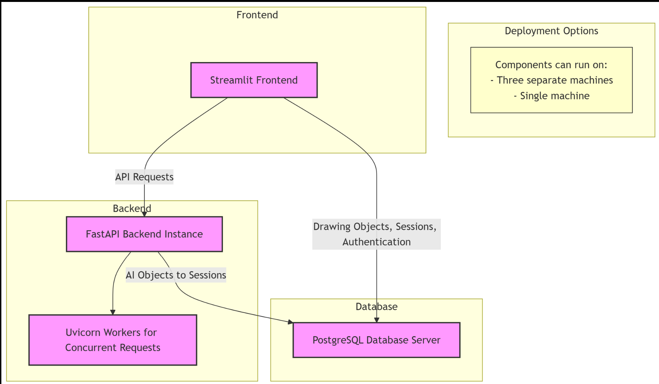
Multiprocessing
PostgreSQL Database Server
FastAPI Backend Instance
Uvicorn workers for concurrent requests
Streamlit Frontend
Each of these three can separately independently on three different machines, or on the same same machine
Notes:
What to Say:
“Now, let’s talk about how we handle multiprocessing and the architecture behind NeuroSketch. Our system is divided into three main components:
A PostgreSQL database server to store session data, user input, and artwork metadata
A FastAPI backend that manages communication between the database and frontend, and processes AI-enhanced artwork requests
A Streamlit frontend which presents the drawing canvas and UI to the user.”
“To handle concurrent requests—like multiple users drawing at once—we use Uvicorn workers within FastAPI. This helps with responsiveness and real-time interaction.”
“One of the strengths of our architecture is that each of these components—the frontend, backend, and database—can be deployed independently. That means they can run on different machines for better performance or all together on a single machine for simplicity, depending on the use case.”
Point to the Diagram:
“As shown in the diagram here, we have clear separation of concerns. The frontend sends API requests to the backend, the backend communicates with the database, and Uvicorn ensures the backend scales for concurrent activity. This architecture gives us a flexible and scalable environment to support collaboration and AI-powered drawing.”
location efficiently

Slide 4
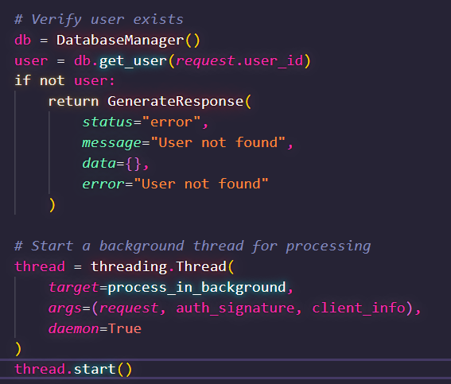
Multithreading
The endpoint for calling AI-generated objects now has background threads for processing
For each request, a thread for running the task
Tracking of each worker and logging to monitor requests
Frontend receives confirmation of request and offloads the work to the backend
Notes:
Multithreading
Implements real-time updates across clients for drawing operations
Handles progress updates for AI tasks

Slide 5
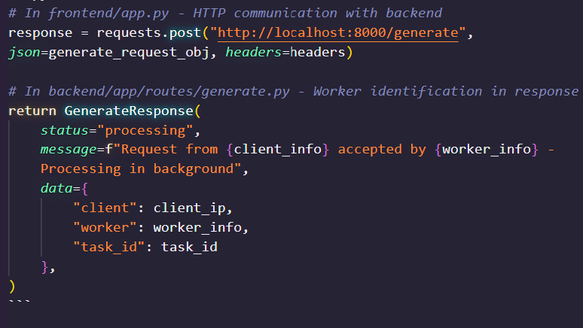
Interprocess Communication
Frontend and backend communicate through HTTP requests
All processes communicate indirectly through PostgreSQL
Private keys are stored via cookies
Note: With HTTPS links, this provides immediate SSL encryption

Slide 6
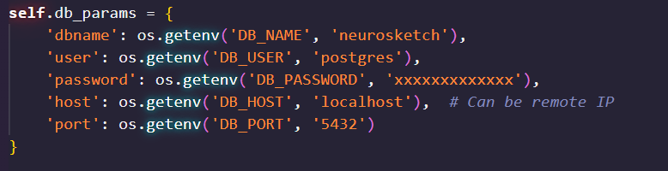
Distributed Computing over Networked Machines
Flexible networking: Database, backend, and frontend can all run on separate machines
As long as they are on the same network, configuration files can guide the application to the right processes it needs
Controller server
Client layer
Worker node
Llm node
Notes:
Controller Server:
Manages authentication, sessions, permissions, and routes for client requests
We didn’t include permissions, only one route
Entry point for all client interactions, validating user identity
Client Layer:
Multiple clients connect to Controller Server, sending drawing operations and LLM requests. Each client receives updates as other users modify a shared canvas, and when LLM requests finish.
Worker Nodes: on the database side
Drawing Node
Process drawing operations, state synchronization and history
LLM Node
Shape generation and chat interactions
Interfaces with OpenAI APIs w/ a parallel task dispatcher
Anthropic, not OpenAI
Still a parallel task dispatcher

Slide 7
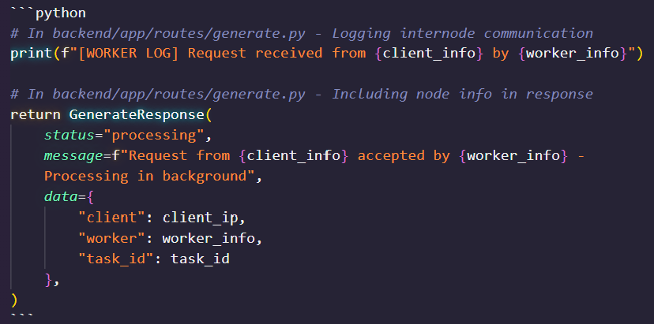
Internode Communication
Clients and workers exchange info about the current processes, allowing the user to see which hostname and worker their AI request was sent to
Notes:
Multiple clients can save to the same database instance - real-time implementations for updating
Multiple clients save call the backend w/ REST - distributed connections and responses

Slide 8
Demo!
Live setup on multiple machines
You get to directly draw, collaborate, invite users, etc.
In case of technical difficulties, we have a one-machine cloud instance ready:
https://neurosketch.ngrok.io

